Slide 1
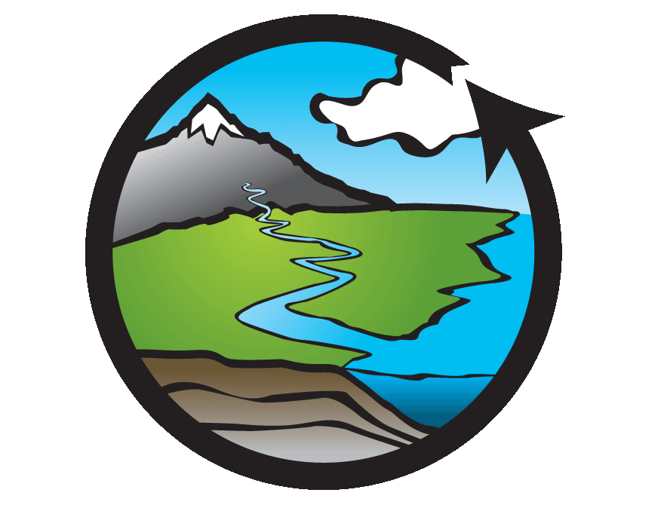

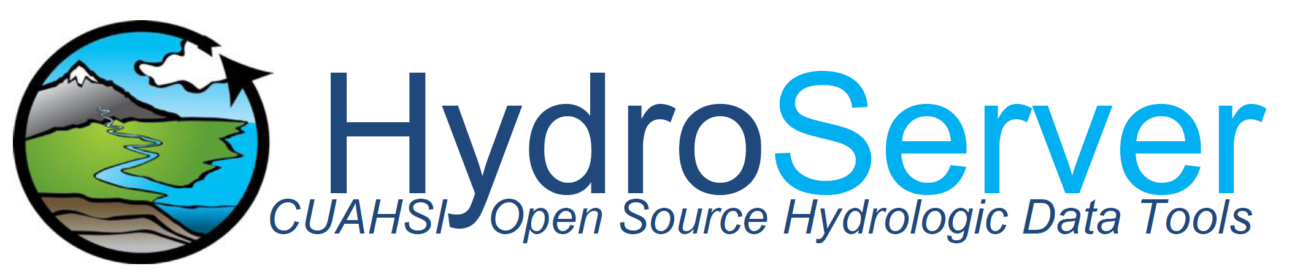
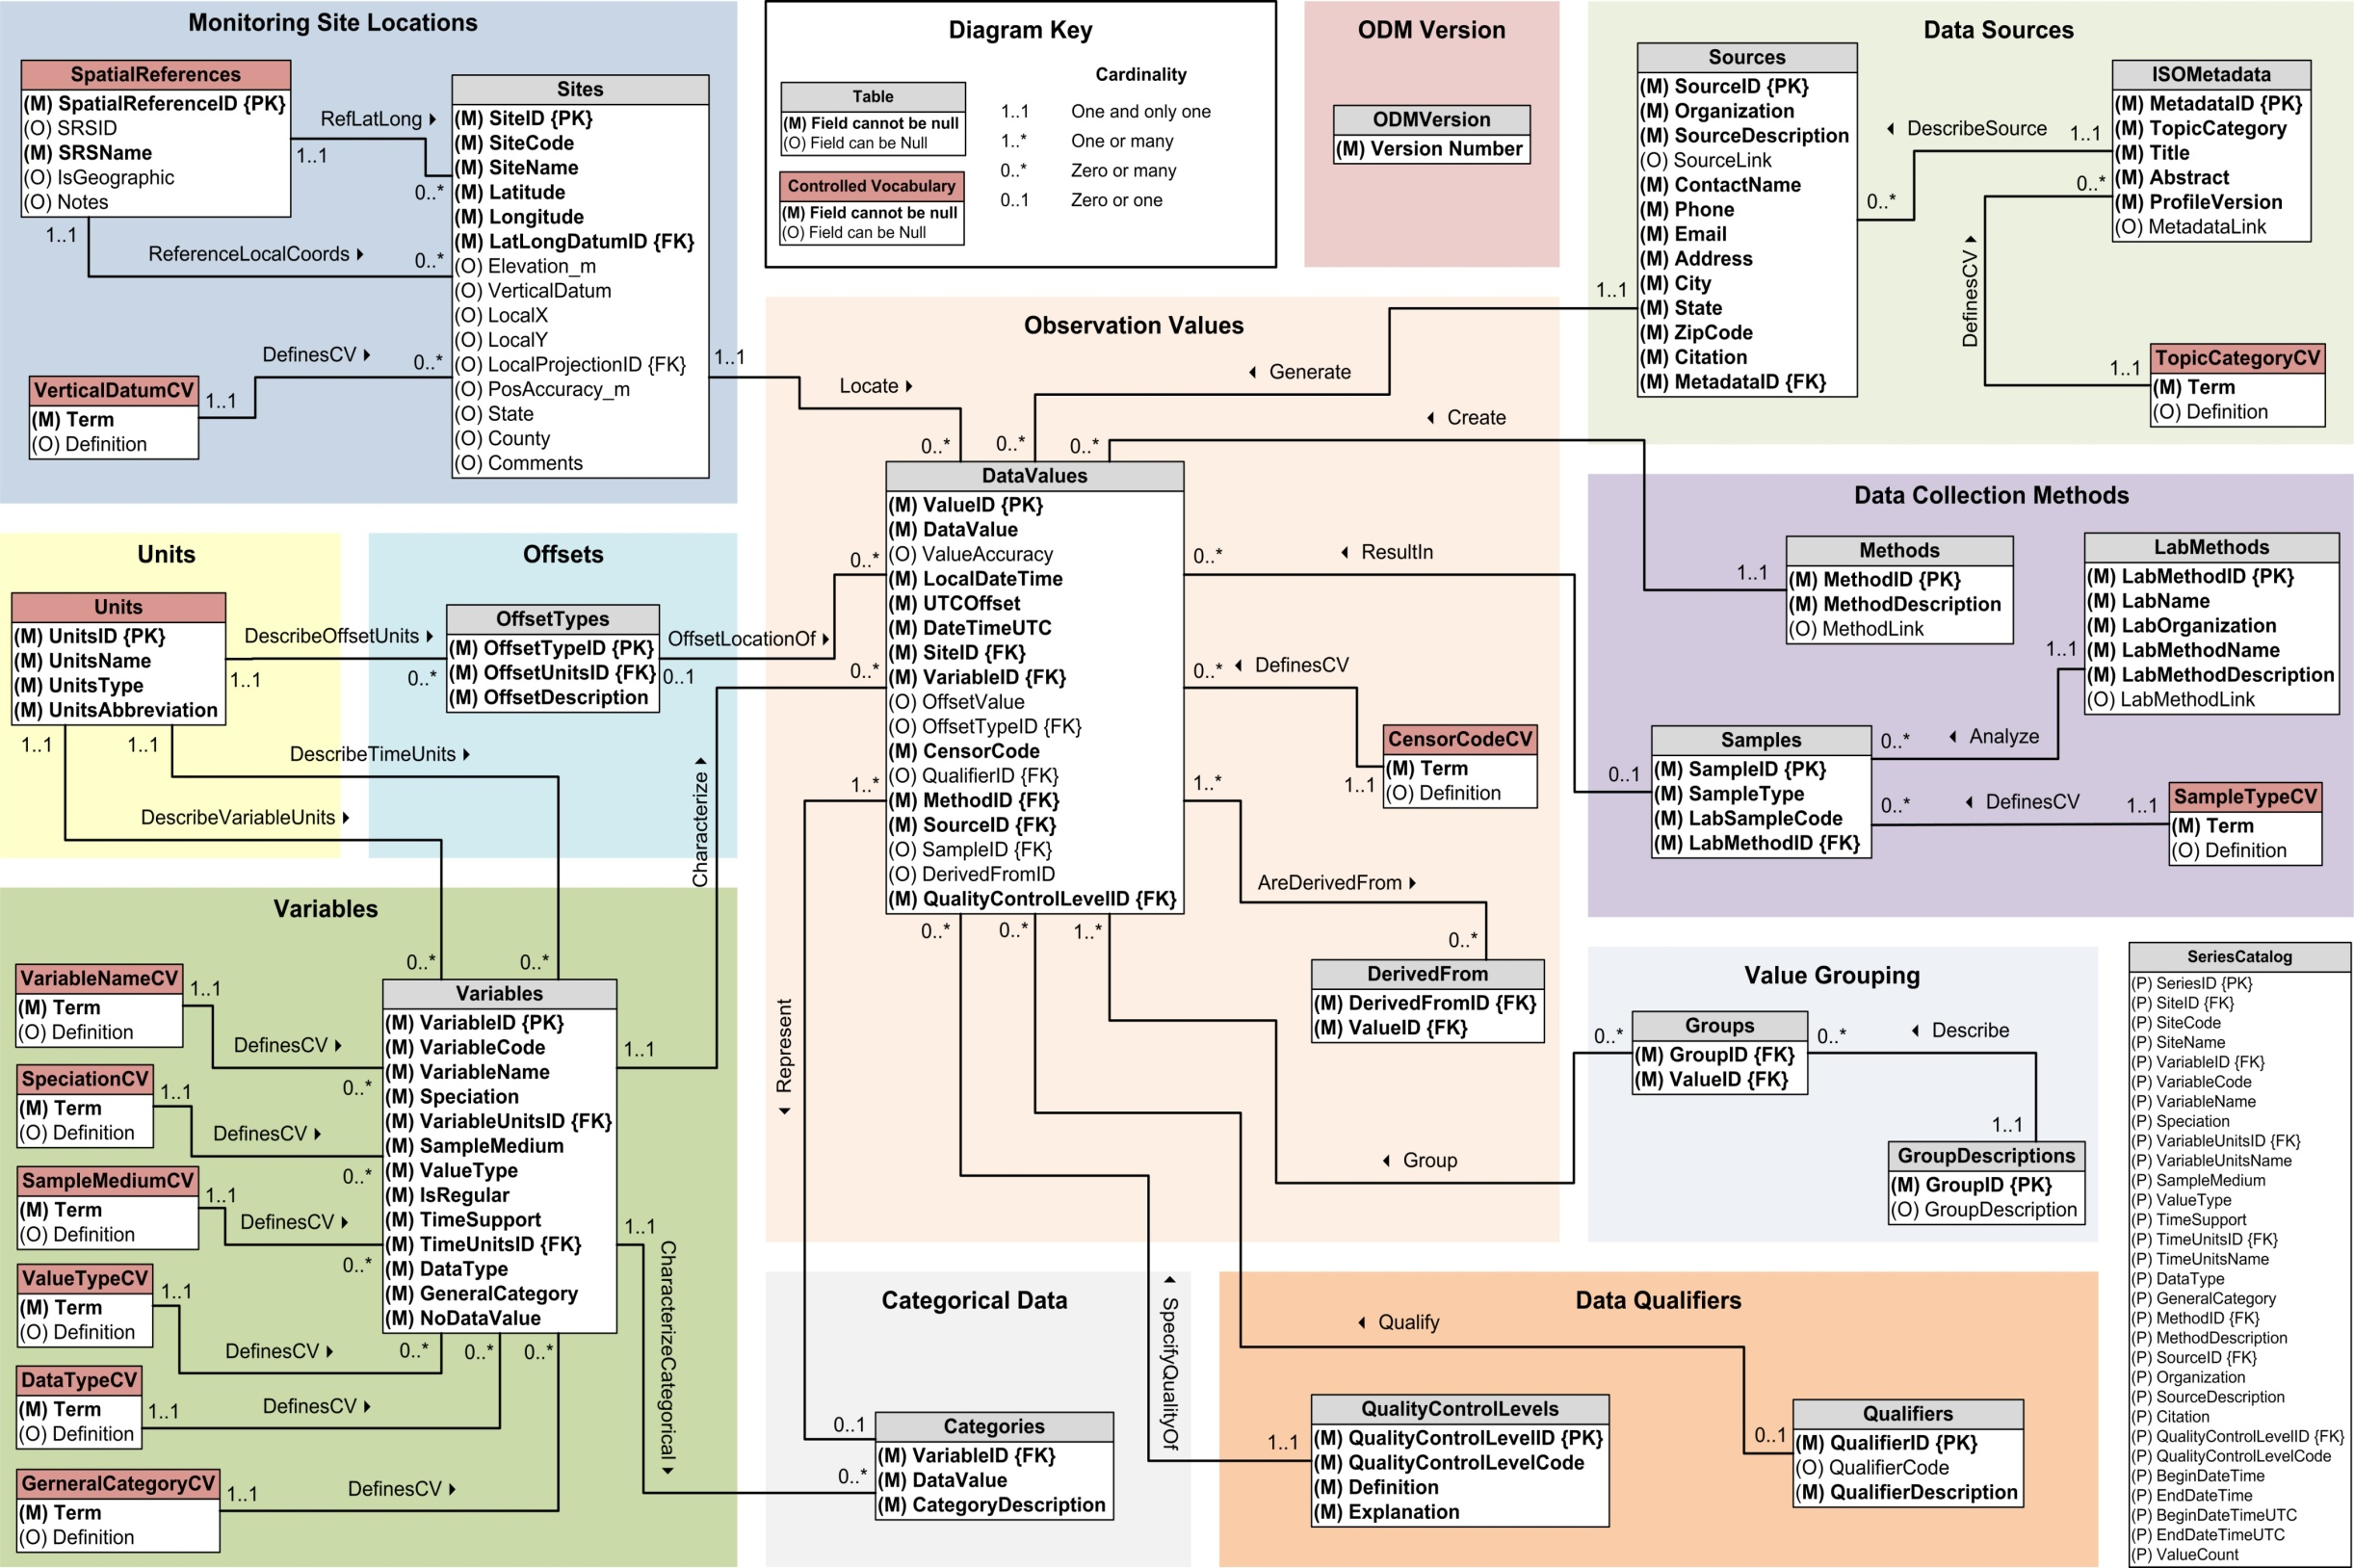
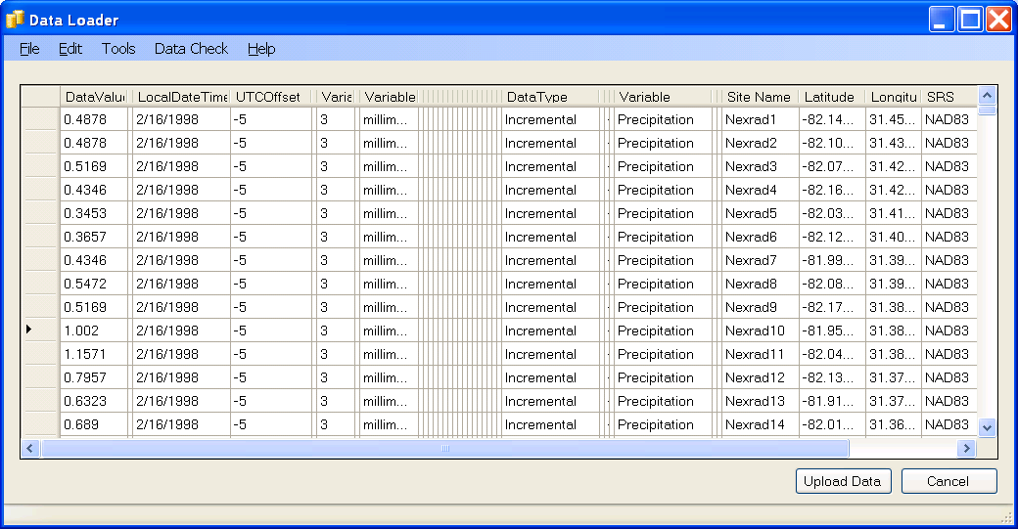
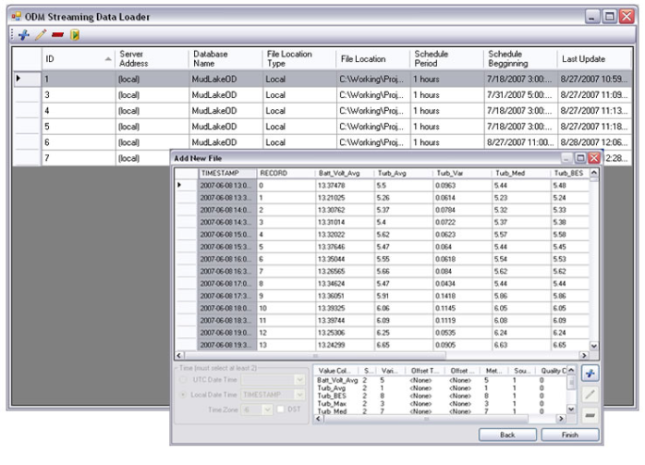
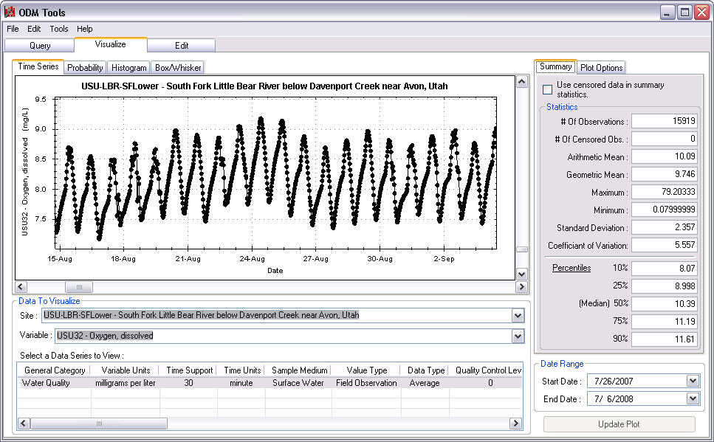
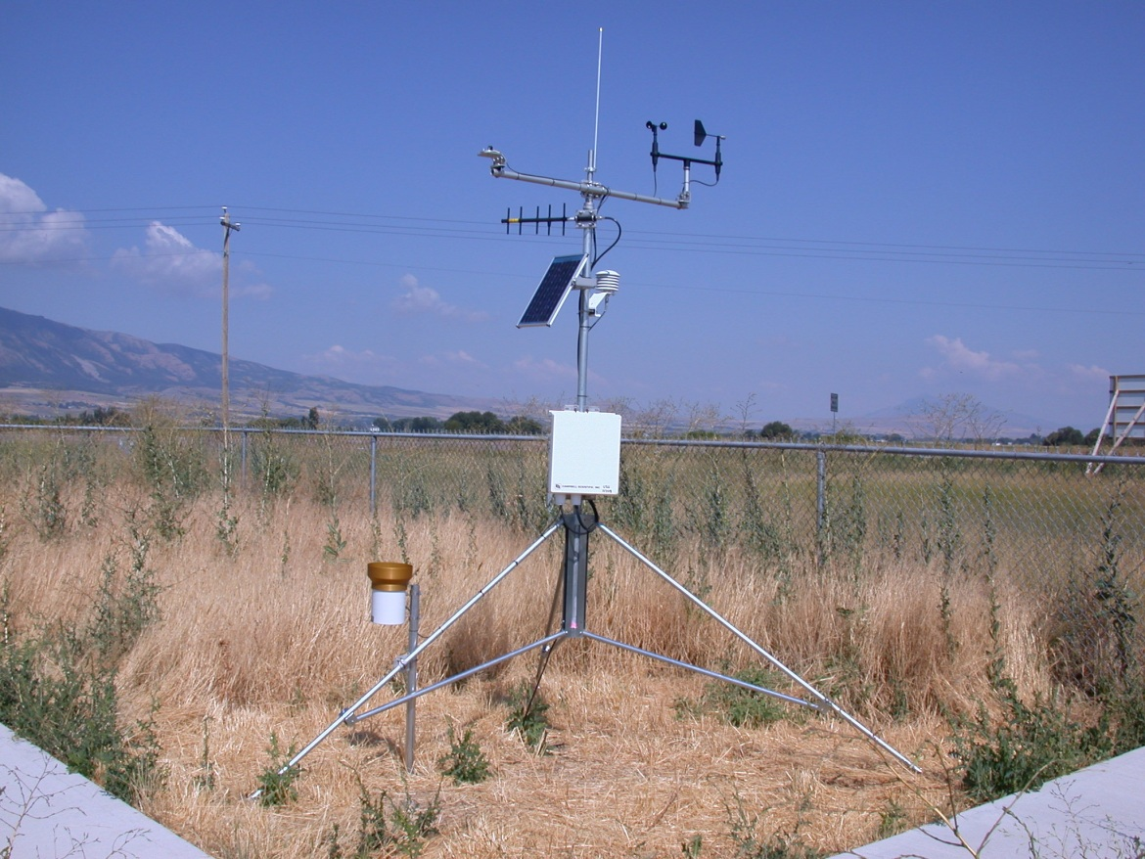
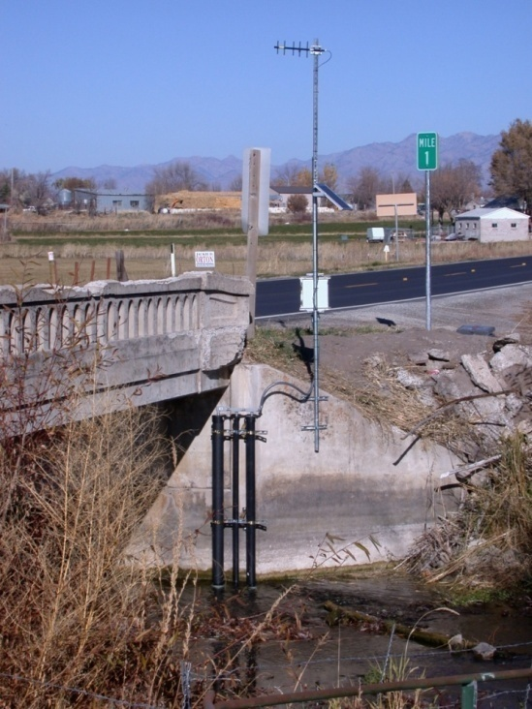
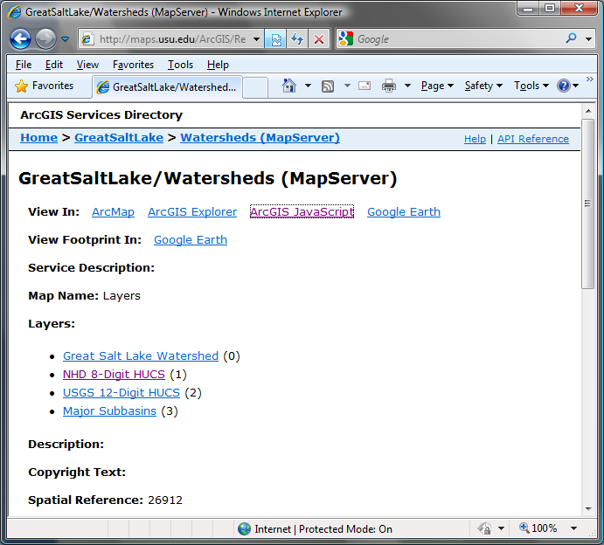

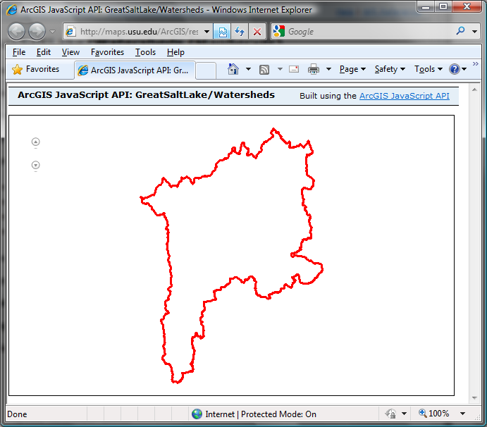
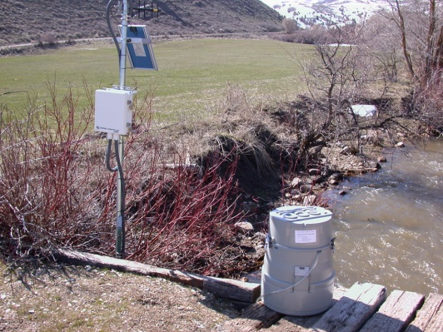
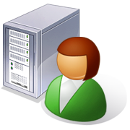
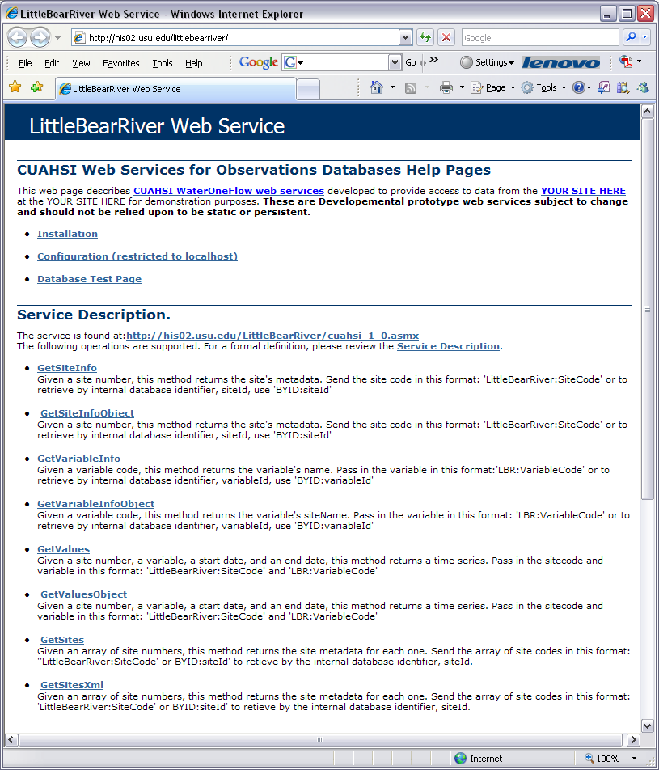
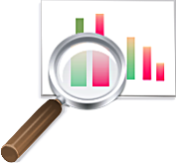
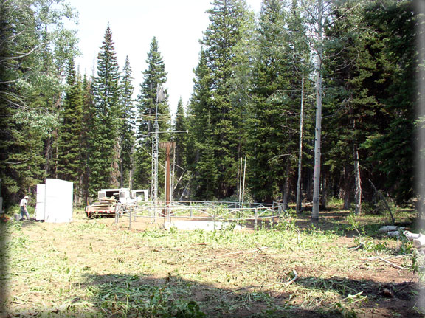
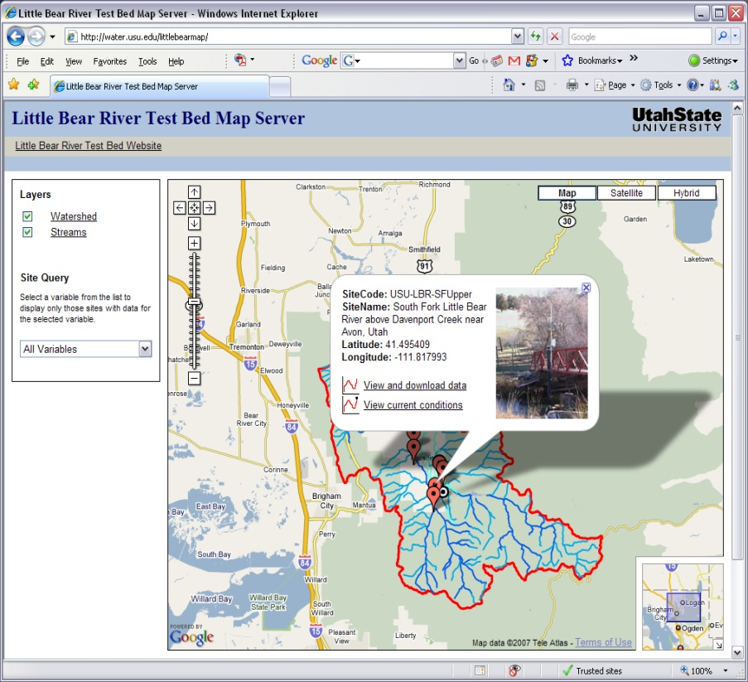
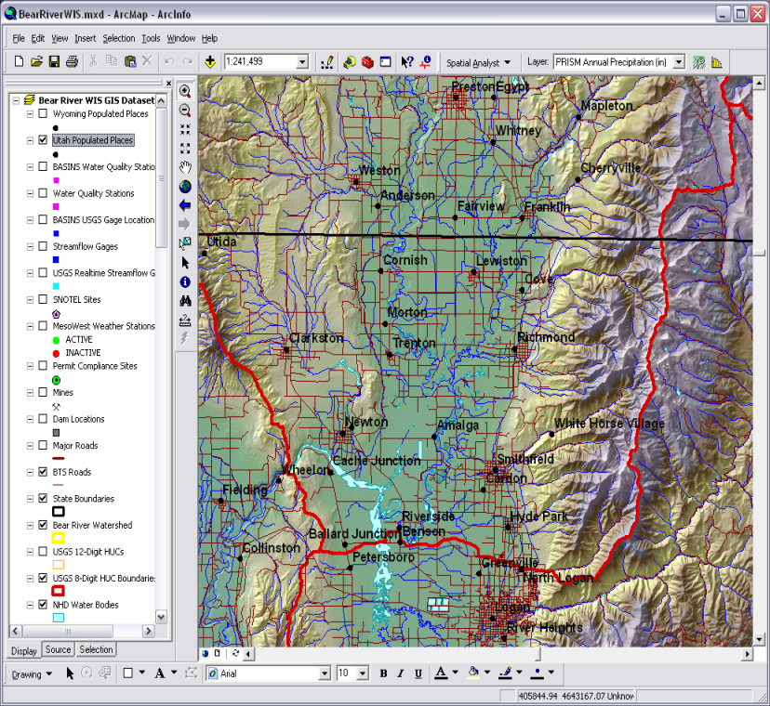
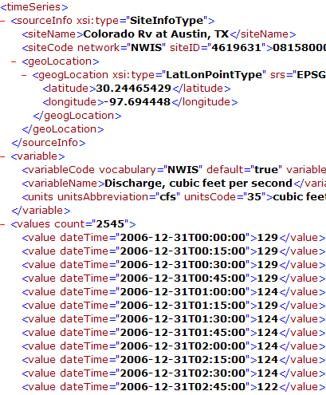
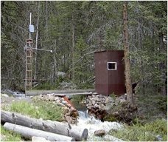
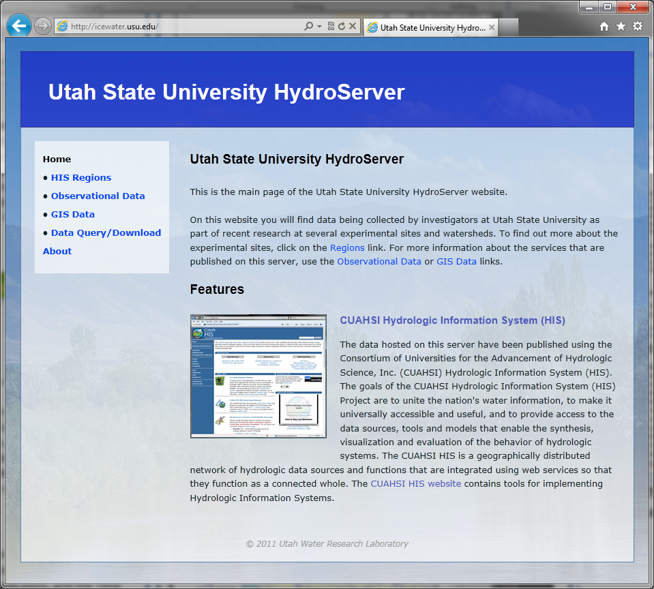
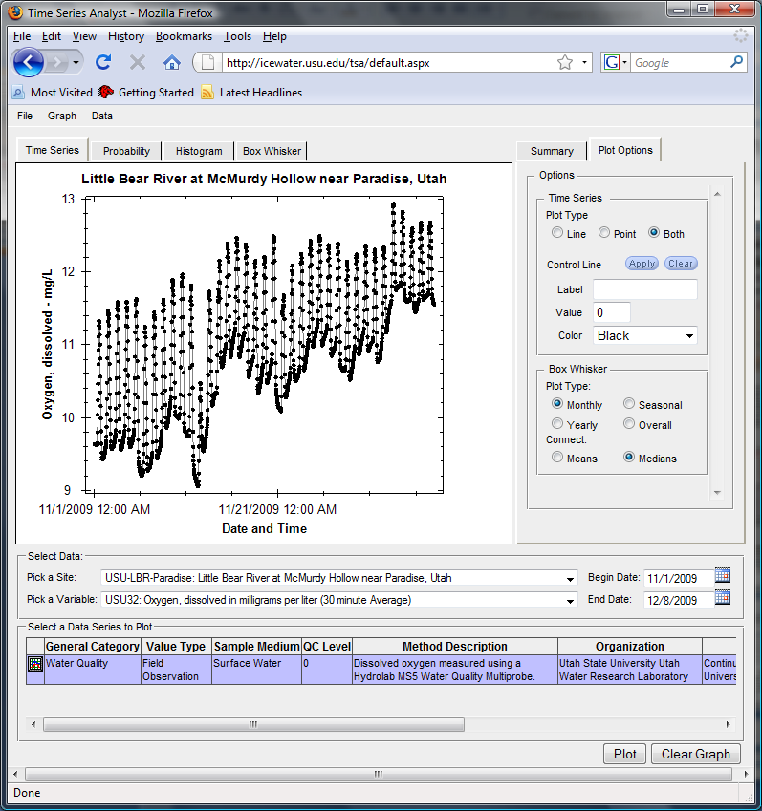
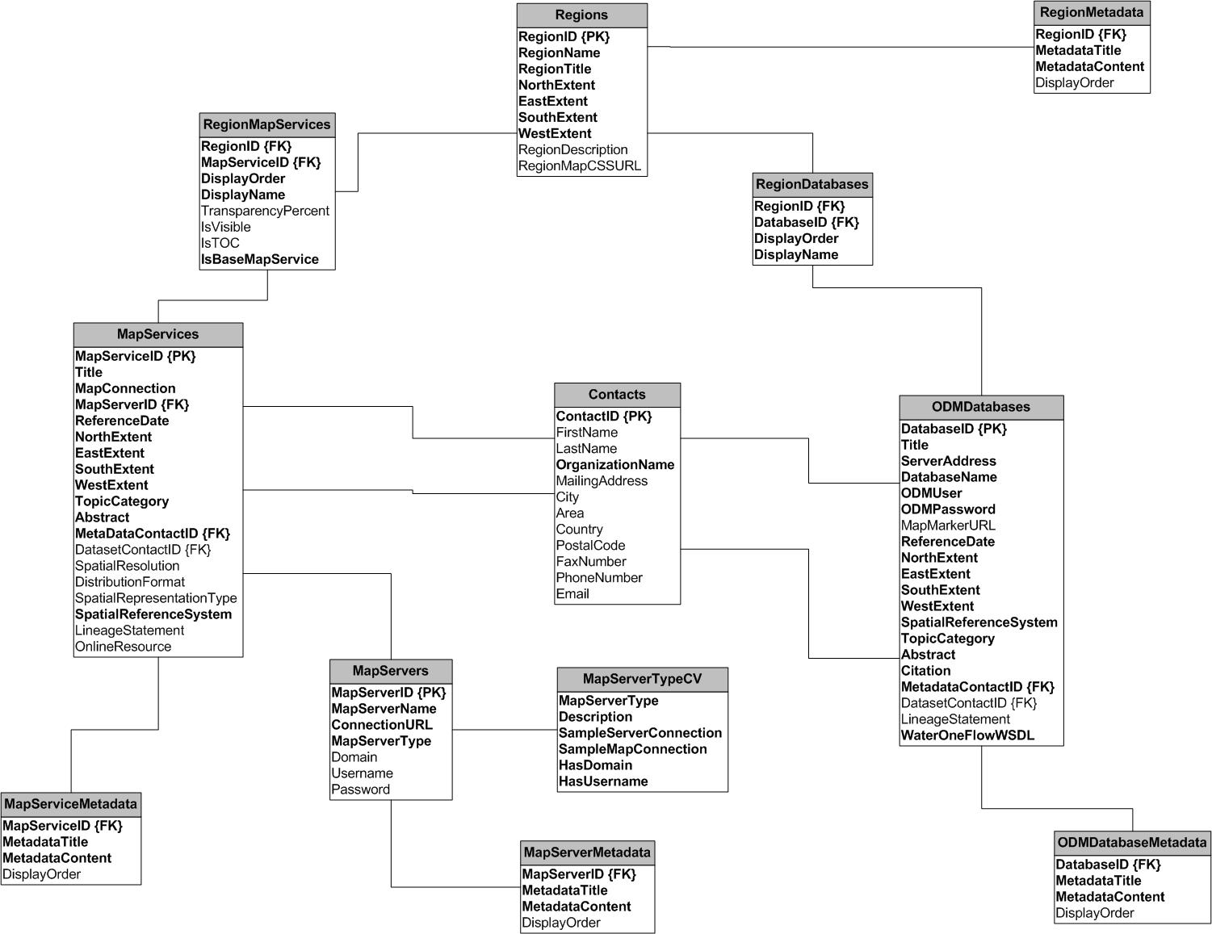
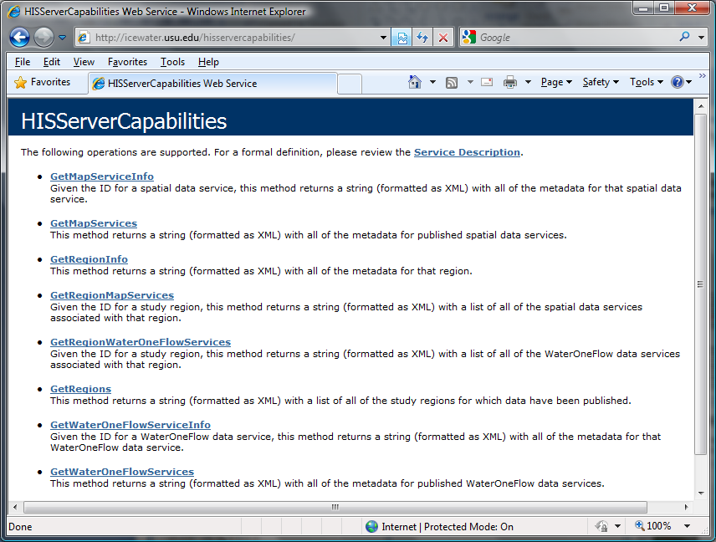
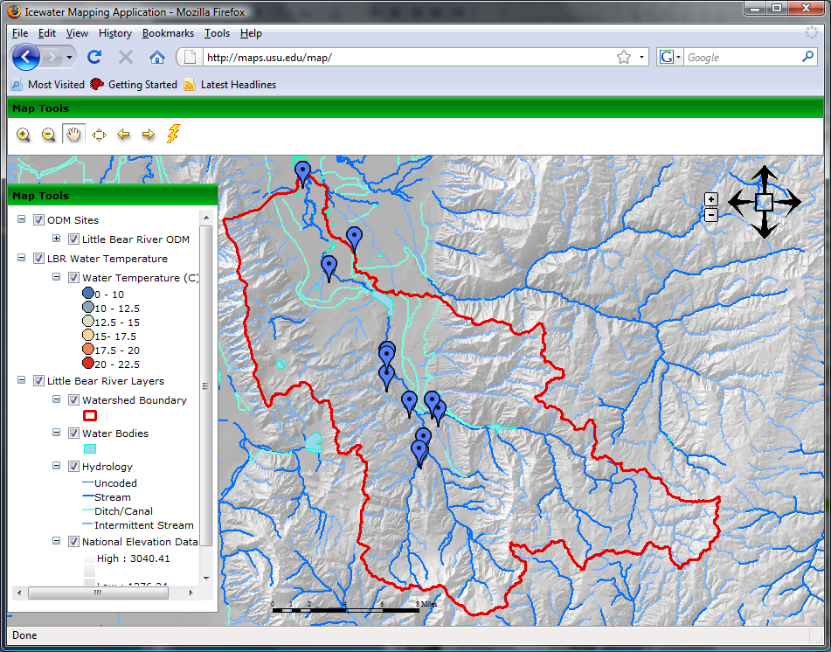
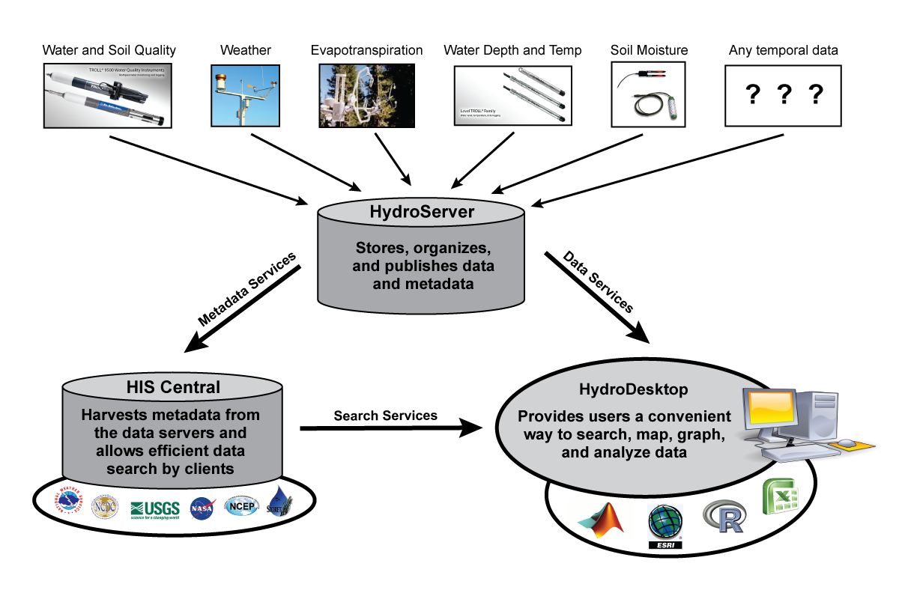
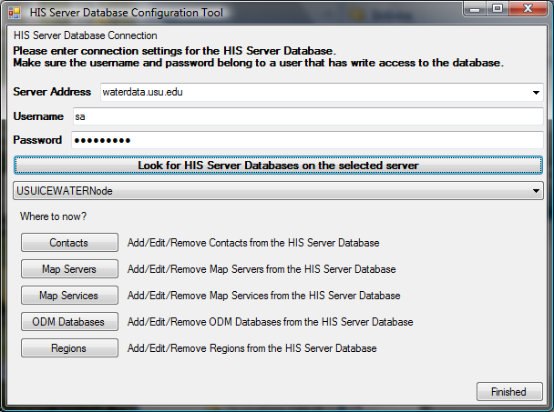

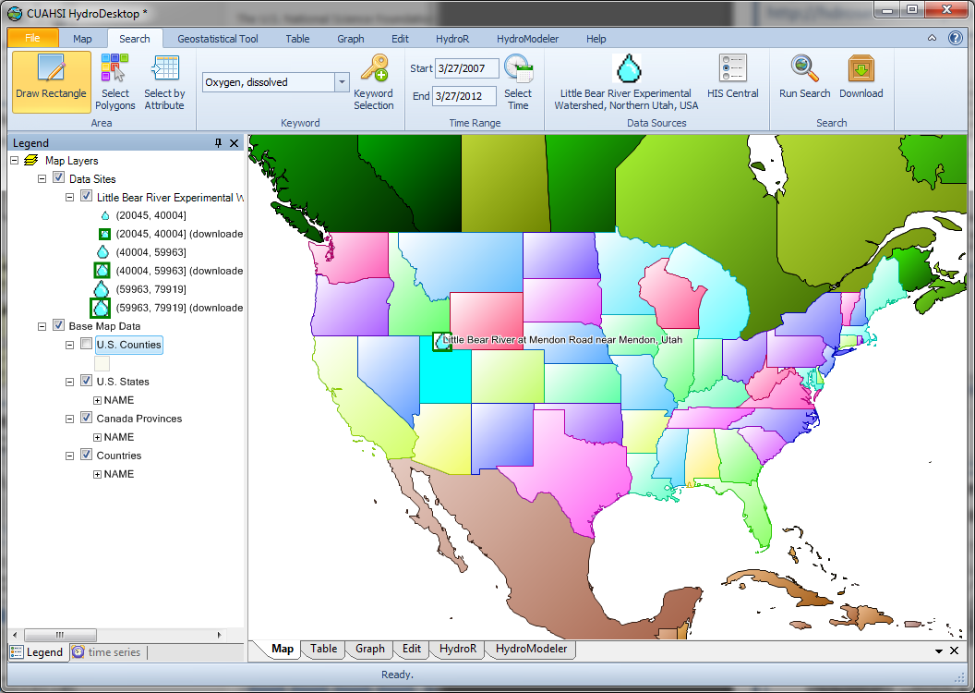

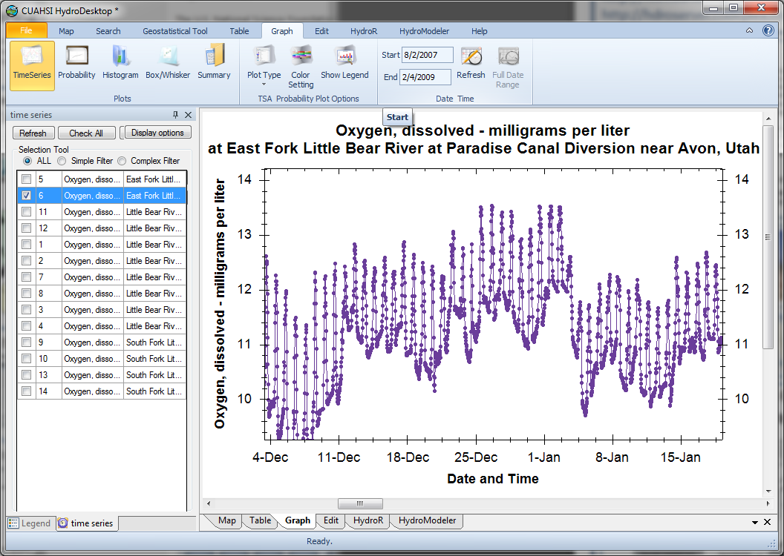
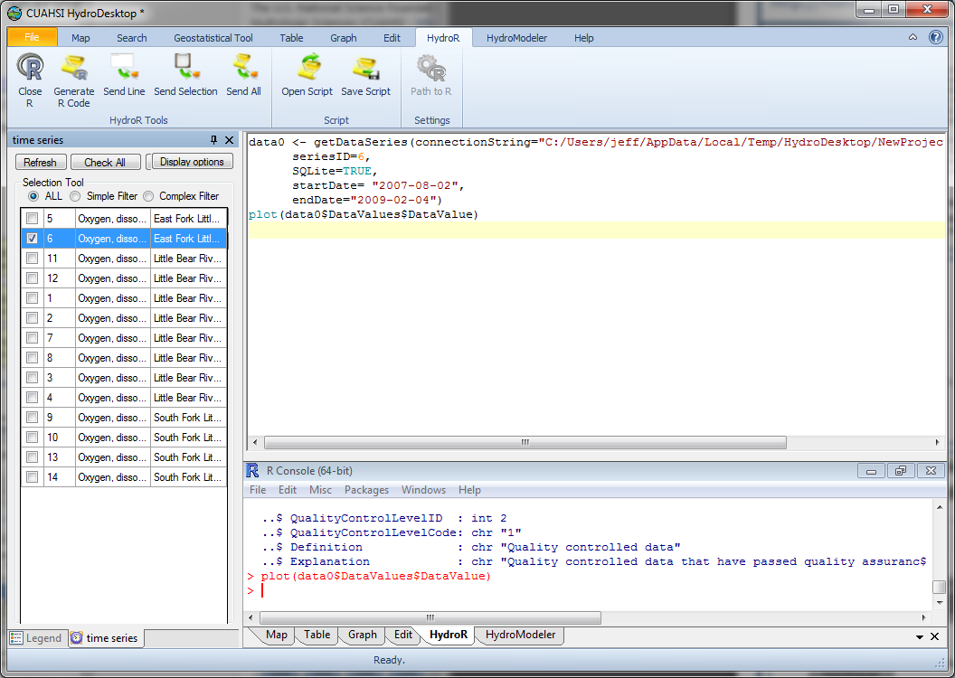
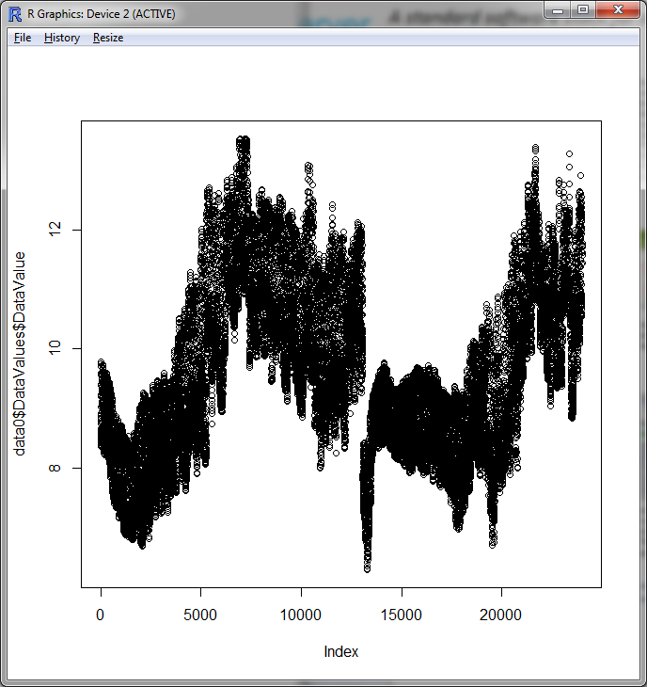



HydroServer: A Platform for Sharing Space-Time Hydrologic Datasets
Open-source development at:
http://hydroserver.codeplex.com
Jeffery S. Horsburgh, David G. Tarboton, Stephanie Reeder
Utah Water Research Laboratory, Utah State University
This work was funded by National Science Foundation Grant EAR 0622374
Abstract
A standard software stack for sharing hydrologic data.
Researchers at agencies and universities have been collecting water resources datasets in experimental watersheds and research sites in the United States and elsewhere. Integration of data from these sites may facilitate cross-site comparisons and large scale studies that synthesize information from diverse settings, making the synthesis as a whole greater than the sum of its parts.
The Consortium of Universities for the Advancement of Hydrologic Science, Inc. (CUAHSI) has developed a Hydrologic Information System (HIS) that supports sharing of hydrologic data through web services and tools for data discovery, access, and publication.
HydroServer is a computer server that contains a collection of databases, web services, tools, and software applications that allow data producers to store, publish, and analyze space-time hydrologic datasets.
The Observations Data Model (ODM): ODM provides a standard relational model for storing and managing hydrologic observations made at points. Time series data are loaded into one or more ODM databases, which are implemented in Microsoft SQL Server.
ODM Data Loader
ODM Utilities: Software programs have been created for data managers to interact with ODM databases. The ODM Data Loader and streaming data loader help data managers load data. ODM Tools enables data managers to query, export, visualize, and edit data. ODM Tools provides data QA/QC capabilities.
ODM Streaming Data Loader
CUAHSI-HIS provides web services, tools, standards and procedures that enhance access to more and better data for hydrologic analysis.
ODM Tools
Hydrologic Data
Web Service Call
WaterOneFlow
Point Observations
Stream gages
Continuous water quality sampling
Weather stations
Soil moisture
Snow monitoring
Groundwater level/quality
Spatially Distributed Data
Land use/cover
Terrain
Hydrography
GetSites
GetSiteInfo
GetVariableInfo
GetValues
WaterOneFlow Web Services: WaterOneFlow web services provide a platform, operating system, and programming language independent way of communicating data over the Internet. The contents of each ODM database are published n WaterML format using WaterOneFlow Web Services.
Data Consumer
WaterML
Publication of Spatial Datasets: ArcGIS Server is used to publish spatial datasets for experimental watersheds and study sites. Services are published using OGC WMS, WFS, and WCS.
SQL
Queries
Query
ODM
Database
Response
Web Service Response
CUAHSI HIS: A Services Oriented
Architecture for Hydrologic Data
HydroServer Capabilities: Each service that is published on a HydroServer is cataloged in a capabilities databases along with relevant metadata. A configuration tool is used to edit the capabilities database. Once in the database, a Capabilities Web Service publishes the capabilities of the HydroServer so that it is “self describing.”
HydroServer Web Applications: A standard set of web applications is available for presenting the available data and services on a HydroServer as well as for providing data visualization and download capabilities. These include a HydroServer Website, an Internet Map Application, and the Time Series Analyst.
Accessing Data Published Using HydroServer
Discover and download data using keyword searches
Quickly visualize and analyze downloaded data
Integrate with R
Three categories of web services in the CUAHSI HIS architecture:
Data Services – which publish observational data
Metadata Services – which publish metadata about specific collections or series of observational data
Catalog and Search Services – which enable search, discovery, and selection of data and convey metadata required for accessing data using data services
Supports search by location and type of data across multiple observation networks including NWIS and STORET
Contact Information
Jeffery S. Horsburgh, (435) 797-2946, jeff.horsburgh@usu.edu
We invite input and feedback from the Hydrologic and Environmental Science Community in meeting the specific needs for data management and sharing.
David G. Tarboton, (435) 797-3172, david.tarboton@usu.edu
Stephanie Reeder, (435) 797-7176, stephanie.reeder@usu.edu

